Slide 1
Training and Test Splits

Slide 2
Learning Goals
In this section, we will cover:
- Splitting data into training and testing samples
- Cross-validation approaches
- Model complexity vs. error

Slide 3
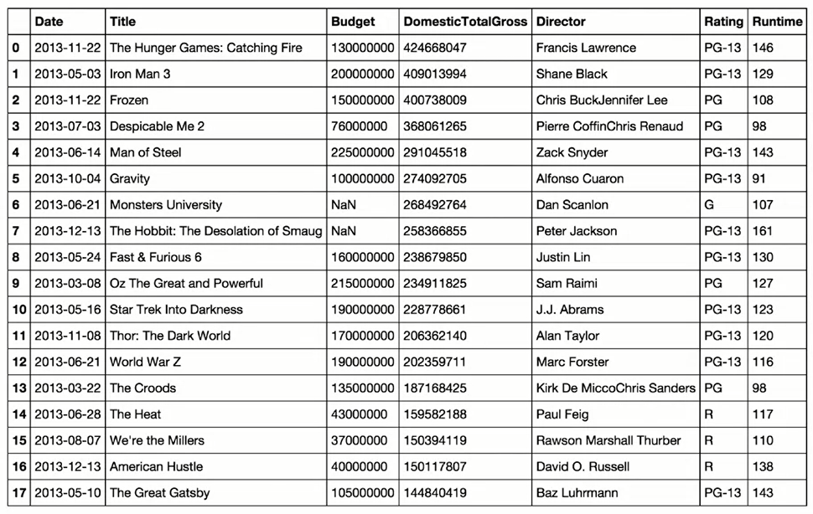
Training and Test Splits

Slide 4
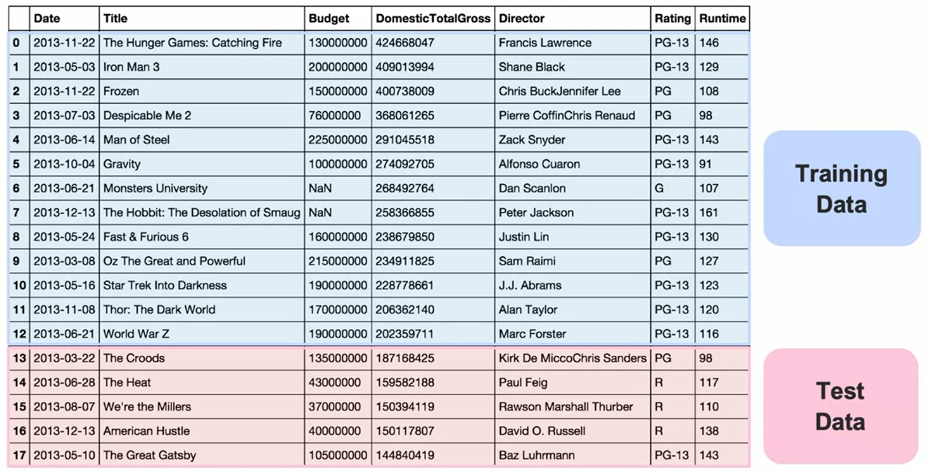
Training and Test Splits

Slide 5
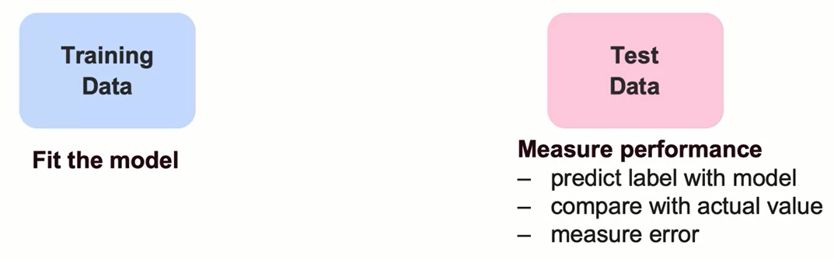
Using Training and Test Data

Slide 6
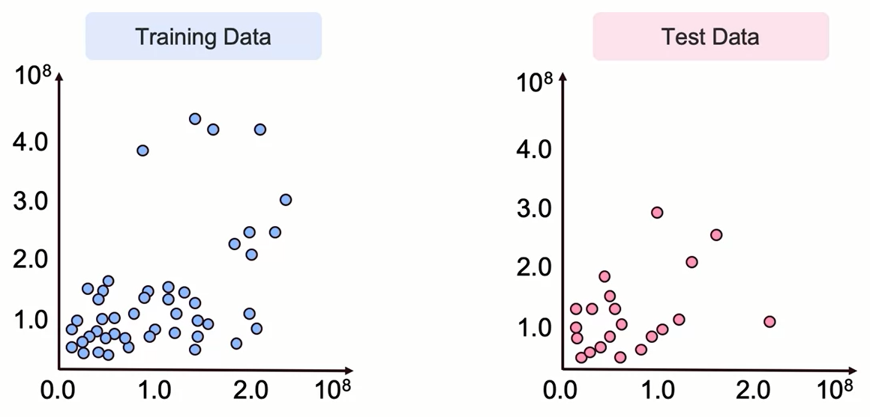
Using Training and Test Data

Slide 7
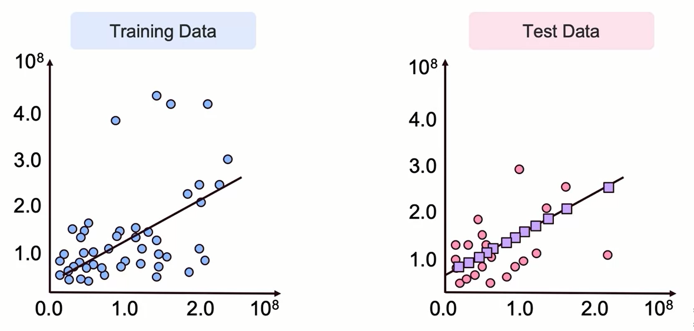
Using Training and Test Data

Slide 8
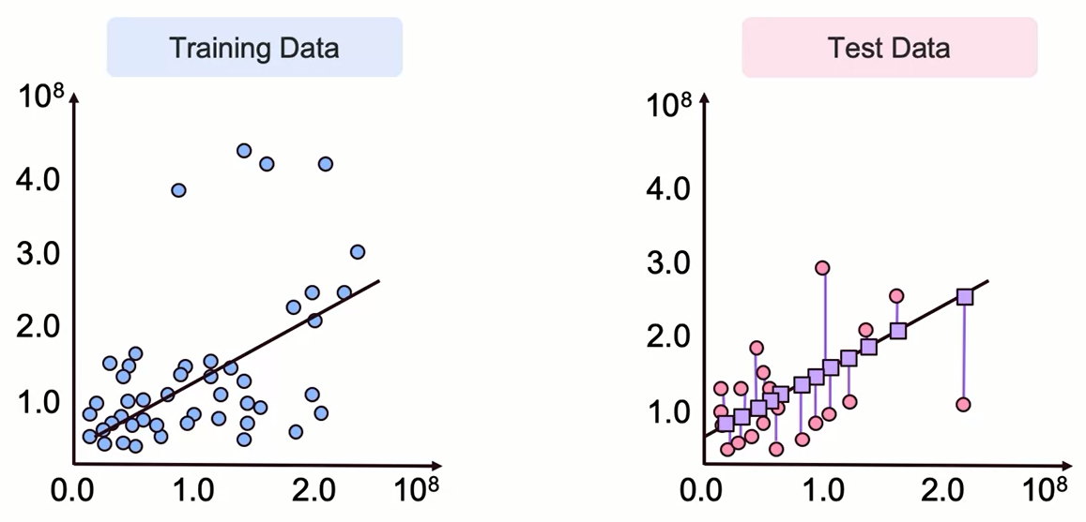
Using Training and Test Data

Slide 9
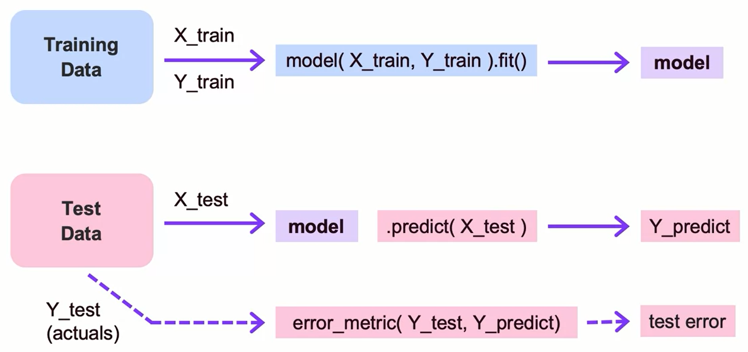
Fitting Training and Test Data

Slide 10
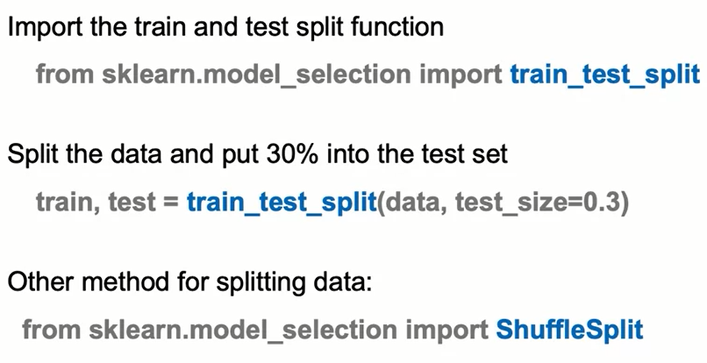
Train-Test Split: The Syntax

Slide 11
Summary
Training and Test Splits
Splitting your data into a training and a test set can help you choose a model that has better chances at generalizing and is not overfitted.
The training data is used to fit the model, while the test data is used to measure error and performance.
Training error tends to decrease with a more complex model.

Slide 12
Learning Recap
In this section, we discussed:
- Splitting data into training and testing samples
- Cross-validation approaches
- Model complexity vs. error

Slide 13
Cross Validation

Slide 14
Learning Goals
In this section, we will cover:
- Identify common cross validation approaches
- Recognize the trade off between model complexity, prediction error and precision error with less data

Slide 15
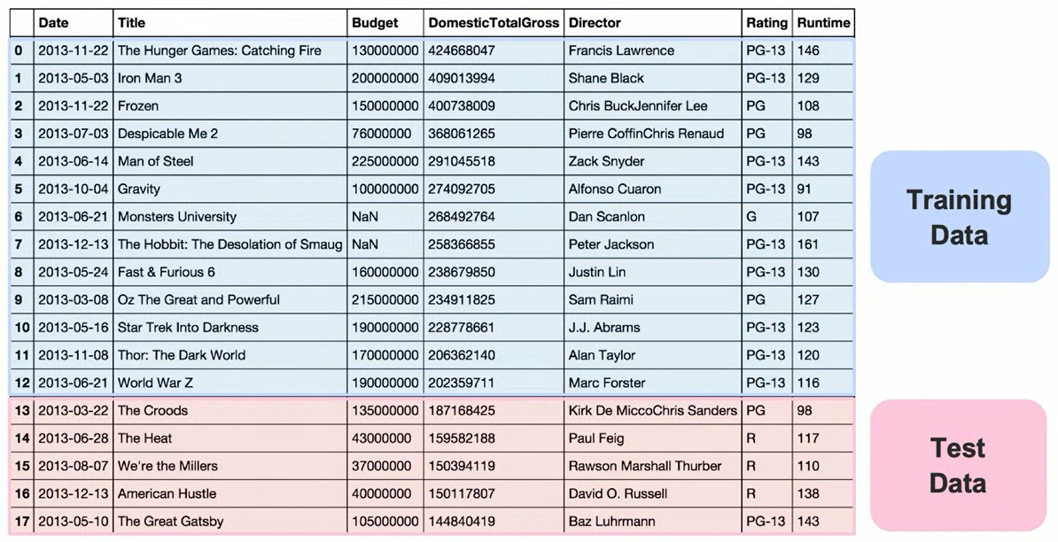
Beyond a Single Test Set: Cross Validation

Slide 16
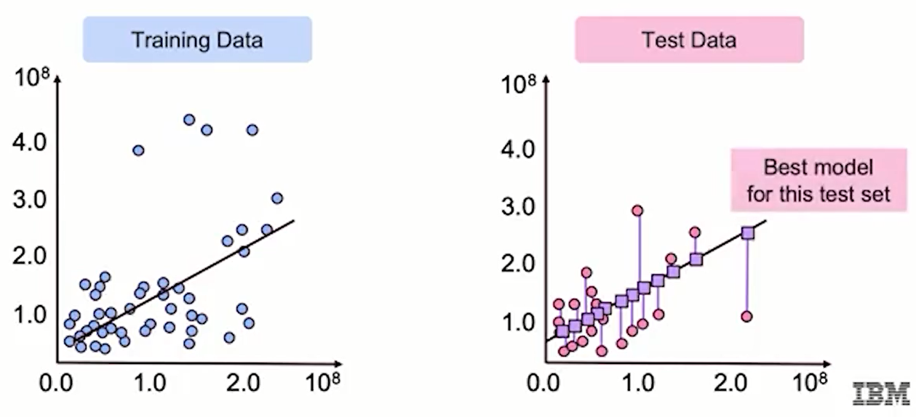
Beyond a Single Test Set: Cross Validation

Slide 17
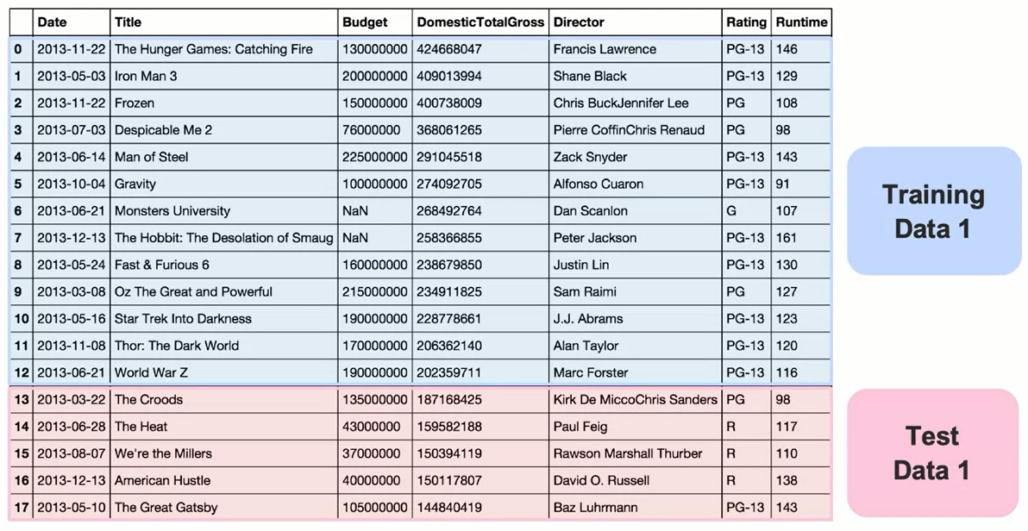
Beyond a Single Test Set: Cross Validation

Slide 18
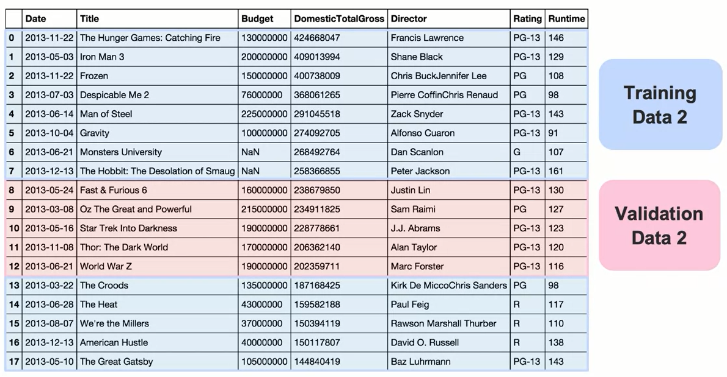
Beyond a Single Test Set: Cross Validation

Slide 19
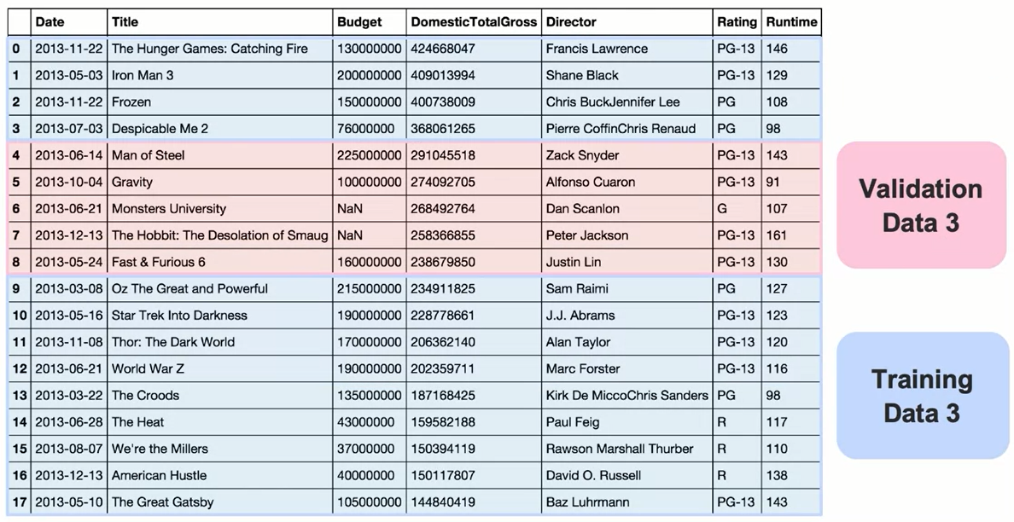
Beyond a Single Test Set: Cross Validation

Slide 20
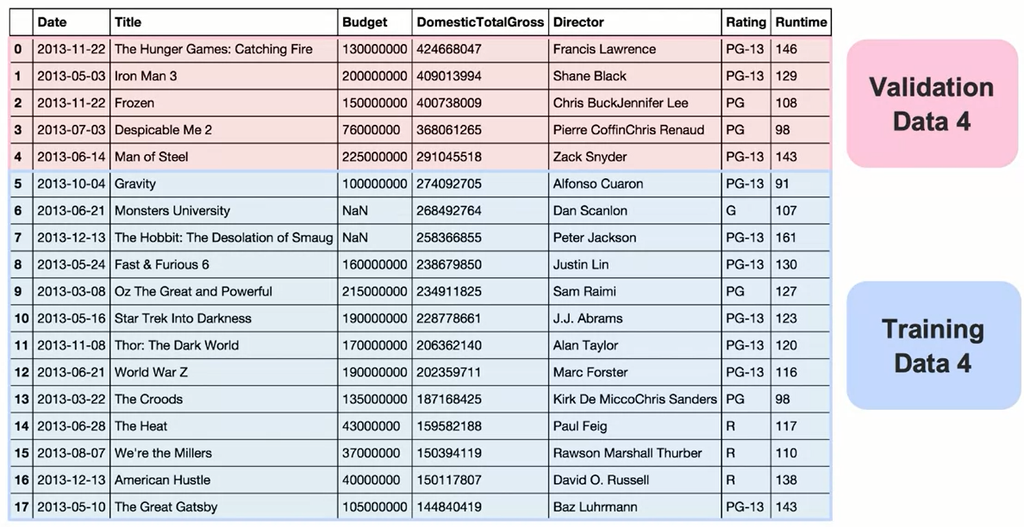
Beyond a Single Test Set: Cross Validation

Slide 21
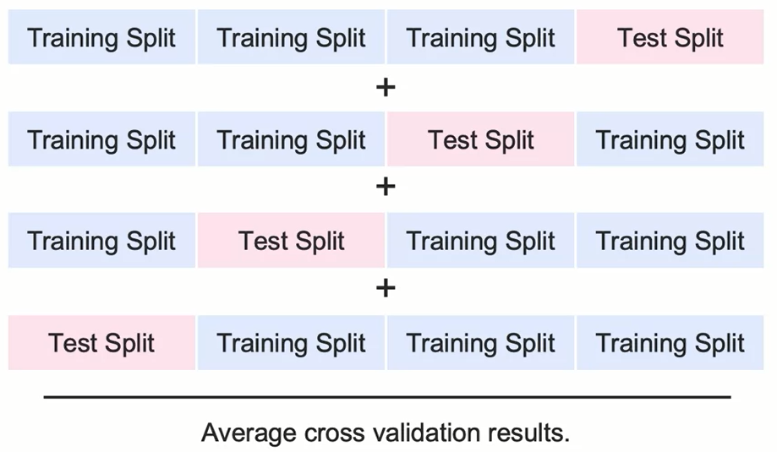
Beyond a Single Test Set: Cross Validation

Slide 22
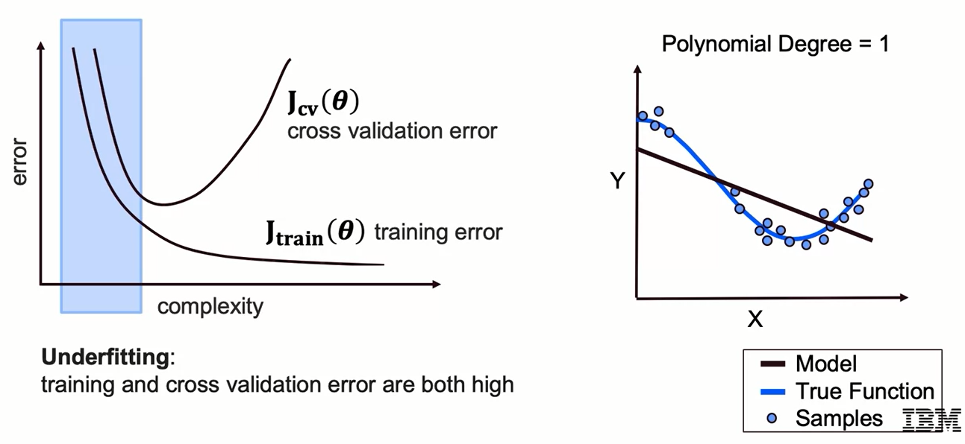
Model Complexity vs. Error

Slide 23
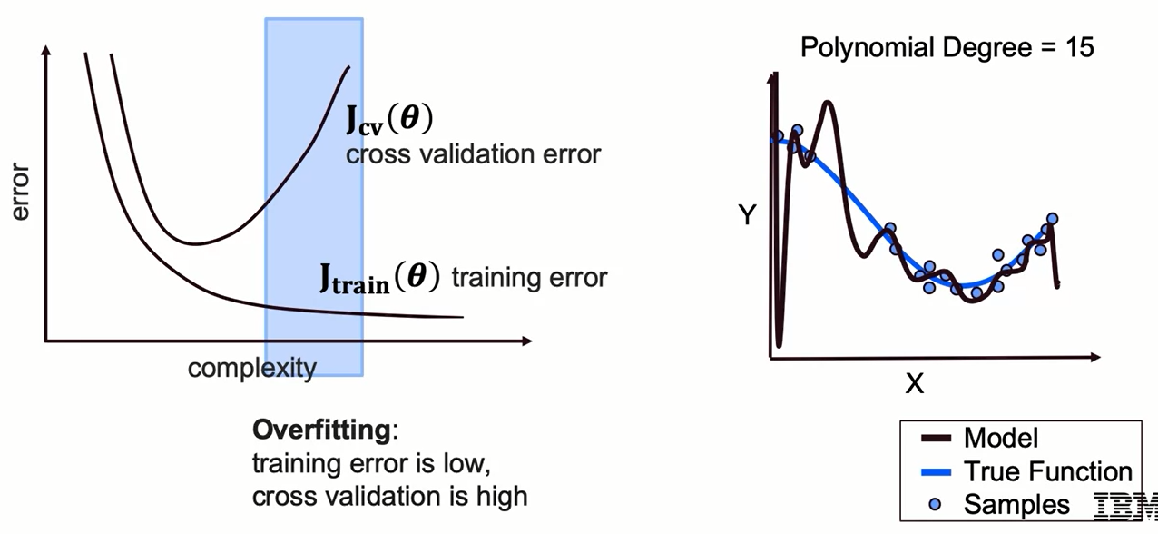
Model Complexity vs. Error

Slide 24
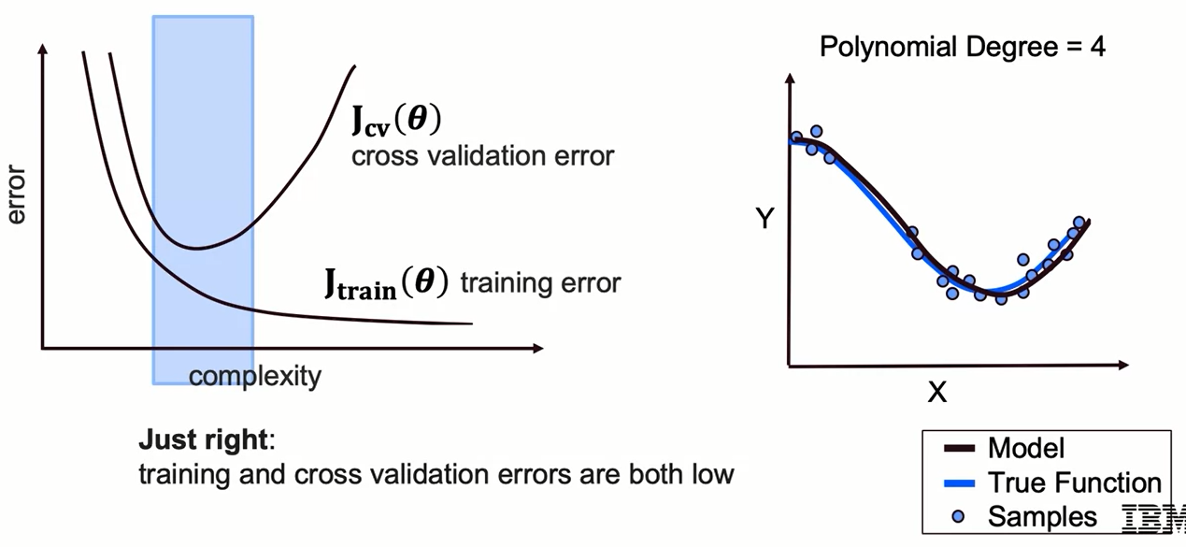
Model Complexity vs. Error

Slide 25
Summary
Cross Validation
The three most common cross validation approaches are:
k-fold cross validation
leave one out cross validation
stratified cross validation
Cross validation method involves dividing the dataset into 3 parts:
training set - is a portion of the data used for training the model
validation set - is a portion of the data used to optimize the hyper-parameters of the model
test set - is a portion of the data used to evaluate the model

Slide 26
Learning Recap
In this section, we covered:
- Identify common cross validation approaches
- Recognize the trade off between model complexity, prediction error and precision error with less data

